Slide 1
How Society Works
The Relational Nature of Man

Slide 2
Society’s Foundational Relationship

Slide 3
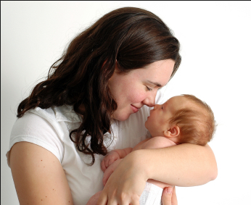


Slide 4


Slide 5
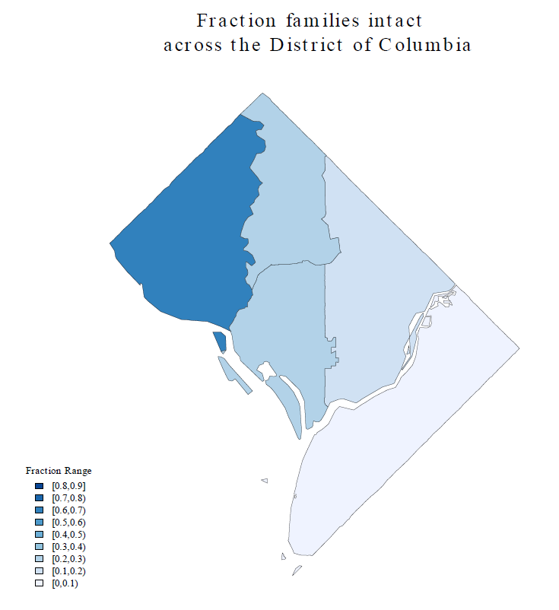

Slide 6
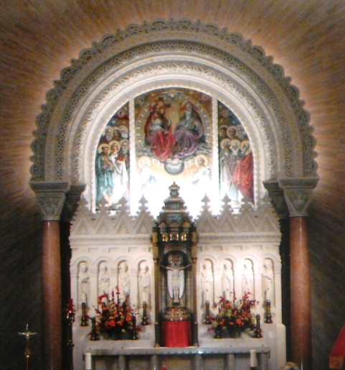
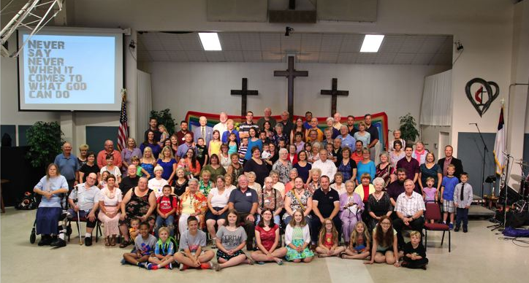
Love God
Love Your Neighbor

Slide 7
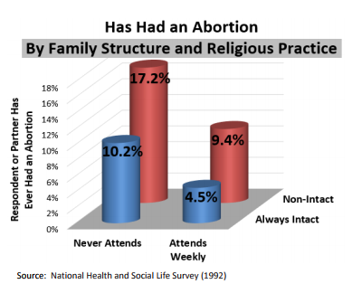
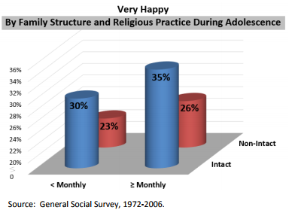
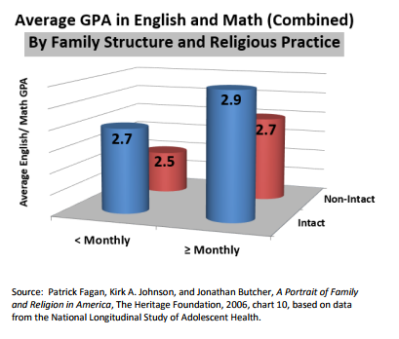
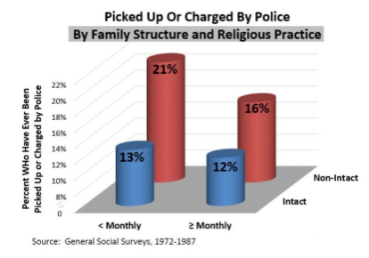
VERY HAPPY
ABORTION
GPA
POLICE

Slide 8
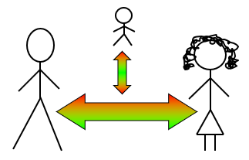
The Christian Family in its Fullness

Slide 9
The 3 Societies or Communities
Family
Church
Polity
Russ Hittinger: “The Three Necessary Societies”, 2017

Slide 10
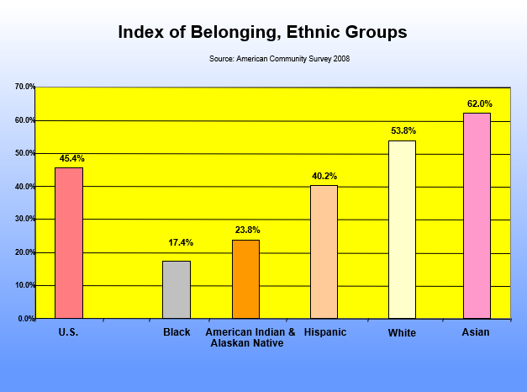

Slide 11
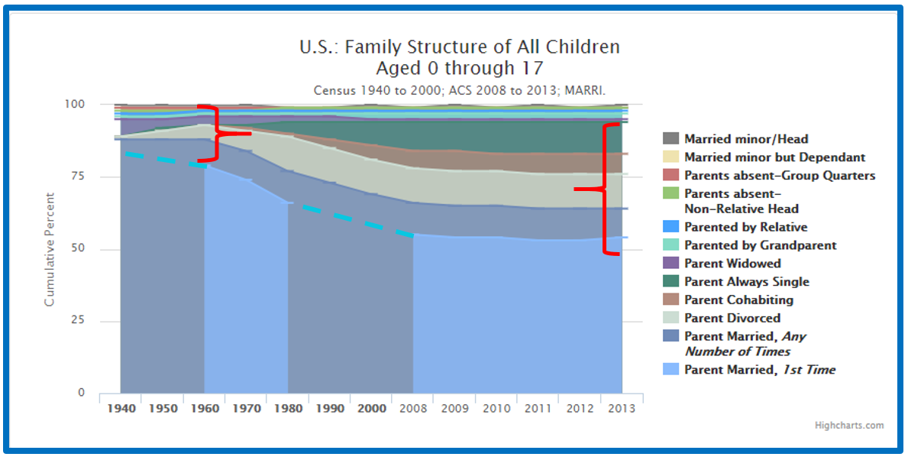

Slide 12
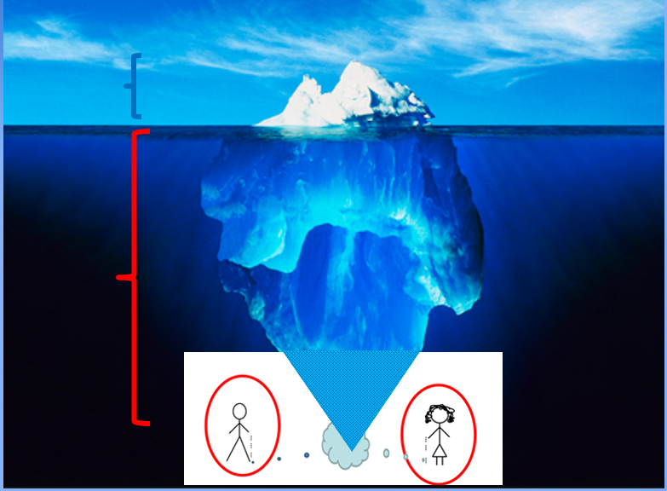

Slide 13
Effects of Contraception
Complementarity of Male and Female

Slide 14
SCHOOL BEHAVIOR DETERIORATION
(1940-62 vs 1963- 2010)
Top 5 Student Behavior Problems Reported by Teachers 1940-1962
Talking
Chewing gum
Making Noise
Running in the Halls
Getting Out of Turn in Line
Top 5 Student Behavior Problems Reported by Teachers 1963-2010
Rape
Robbery
Assault
Burglary
Arson

Slide 15
The Five Basic Institutions
Five Basic Tasks
Instrumental
Government
Market
School
Church
Family
Relational

Slide 16
Natural Law :
Commandments in the negative
Free to choose but not to choose the consequences

Slide 17
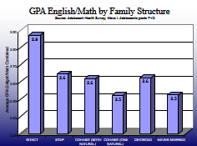
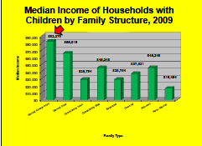

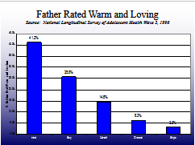
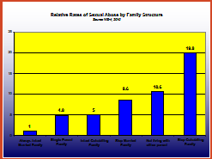
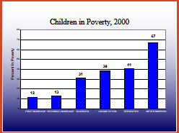
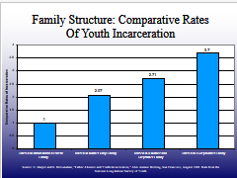
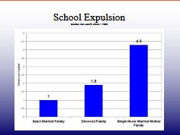
Positive
Negative

Slide 18
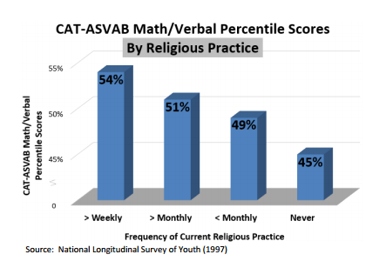
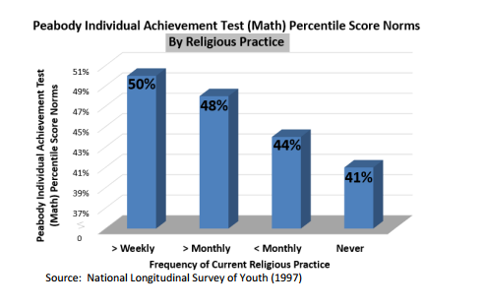
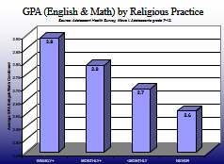
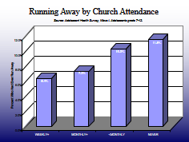
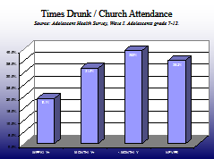
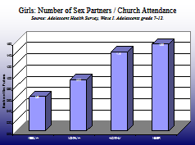
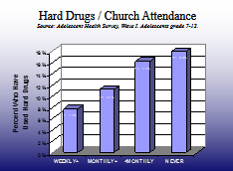
Positive
Negative

Slide 19
Relative Rates of Physical Abuse by Family Structure
Source NIS-4, 2010
12
10.3
10
8
6
5.2
4.3
4
3.6
3.1
2
1.0
0
Always Intact
Single Parent
Not living with
Intact Cohabiting
Step Married
Step Cohabiting
Married Family
Family
either parent
Family
Family
Family
Notes:
This new data (2010) above, is from the U.S. Federal Government’s National Incidence Survey of Child Abuse and Neglect. The always intact married family has the lowest level of physical abuse and the step cohabiting family (biological parent and cohabiting partner) has the highest level of physical abuse.

Slide 20
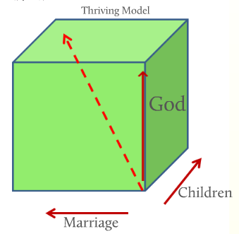
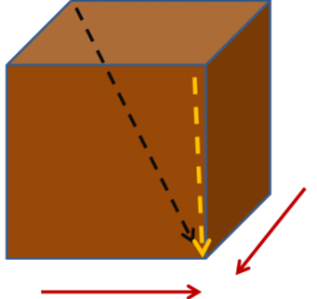
Dysfunctional Model

Slide 21
Right of the Child
Nature of Rights
Political vs. Fundamental Rights

Slide 22
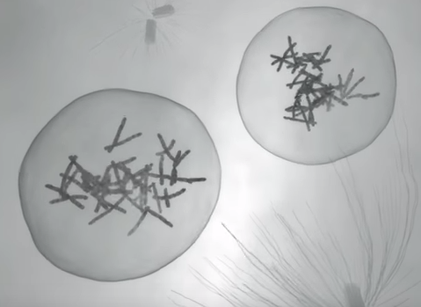
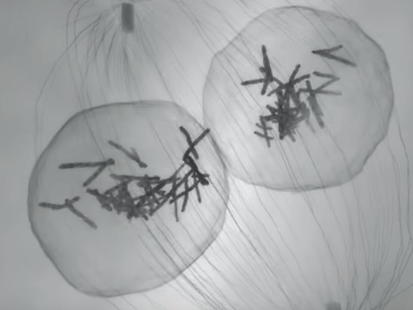
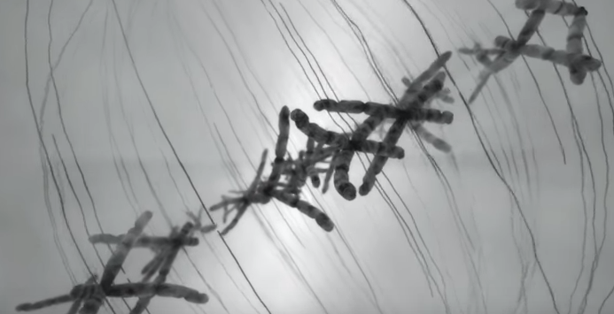
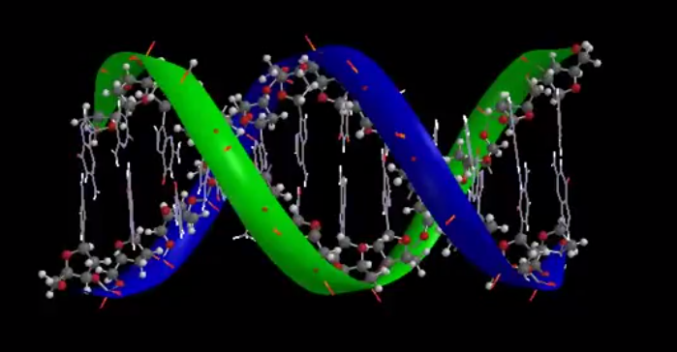
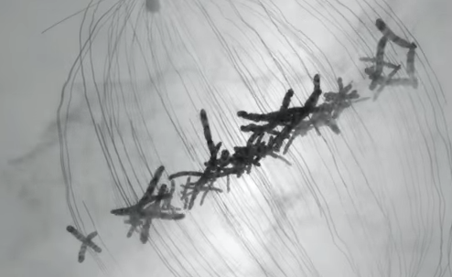
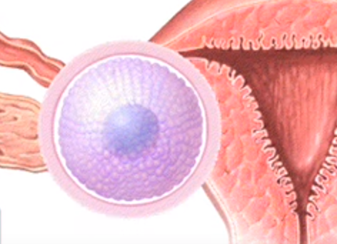
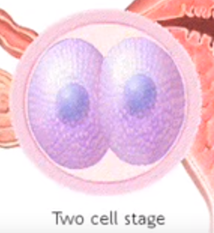
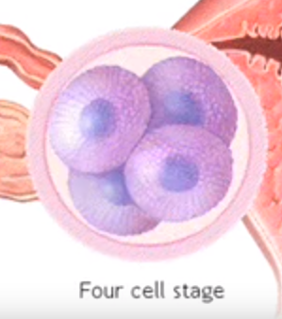
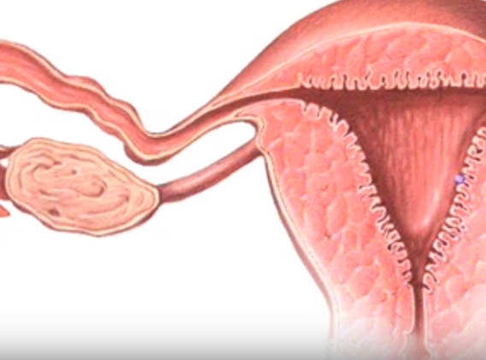
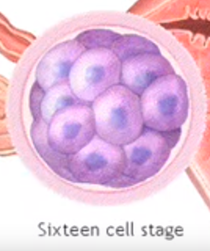

Slide 23
Annual Rejection Ratio: For Every 100 Children Born
Sources: CDC/ NCHS report series
60
40
20
10
Index of Rejection
Divorce
0.0
OWB
1950
1955
1960
1965
1970
1975
1980
1985
1990
1995
1998
2000
Notes:
Over the last sixty years more and more children have experienced the separation of their parents – rejecting each other – either before marriage (Out-of-Wedlock births) or after marriage, in divorce. Similar rejections happen very frequently among cohabiting parents (the dotted line).
In 1950 for every 100 children born:
12 experienced the splitting of their parents that year:
4 out of wedlock
8 through their parents divorcing that year
The next slide shows accurate data for the year 2008.

Slide 24
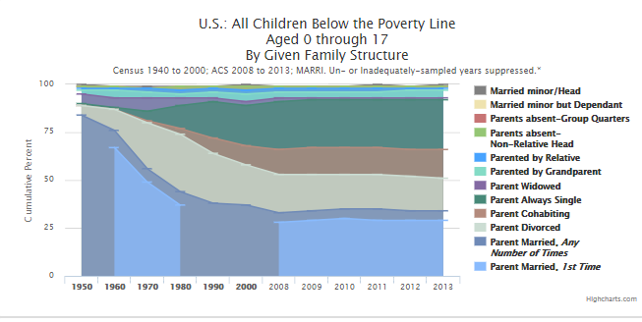

Slide 25
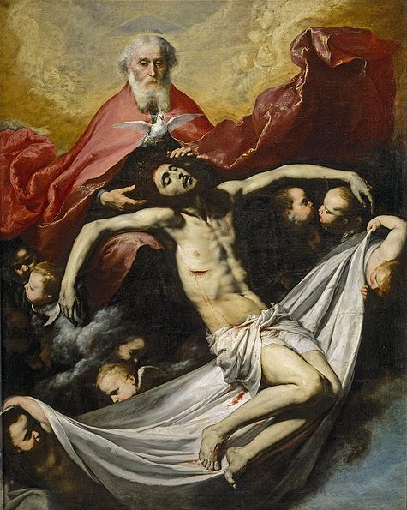

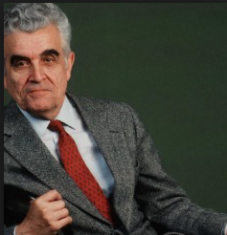
Imitators

Slide 26
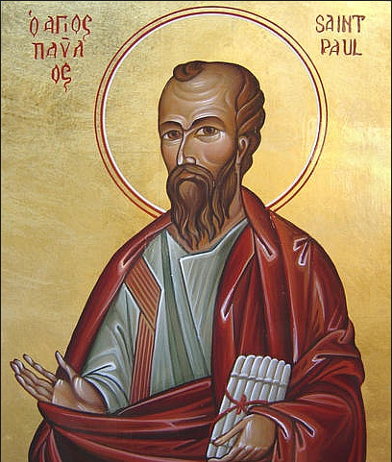
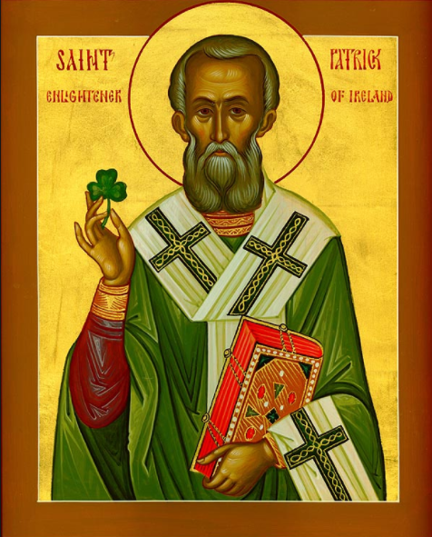
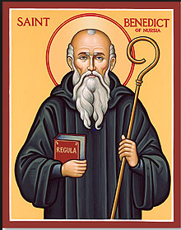
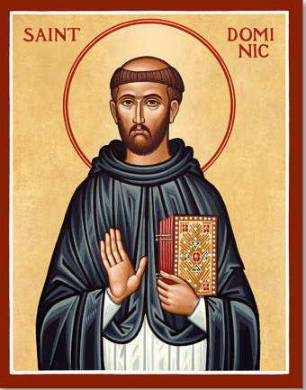
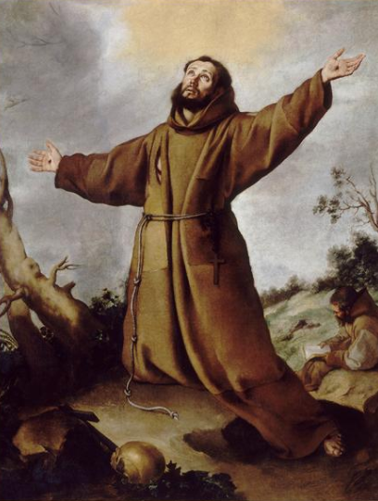
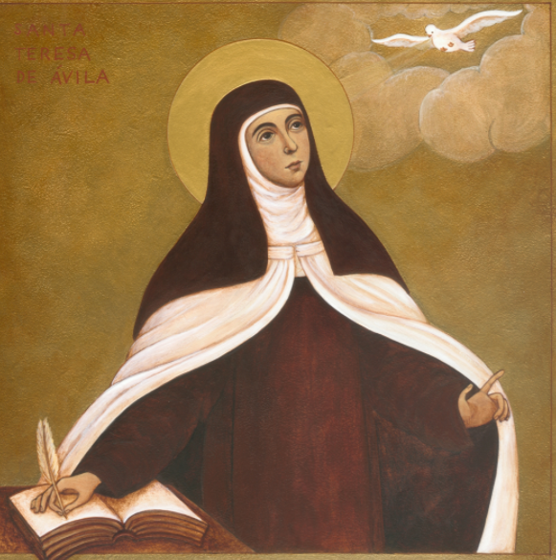
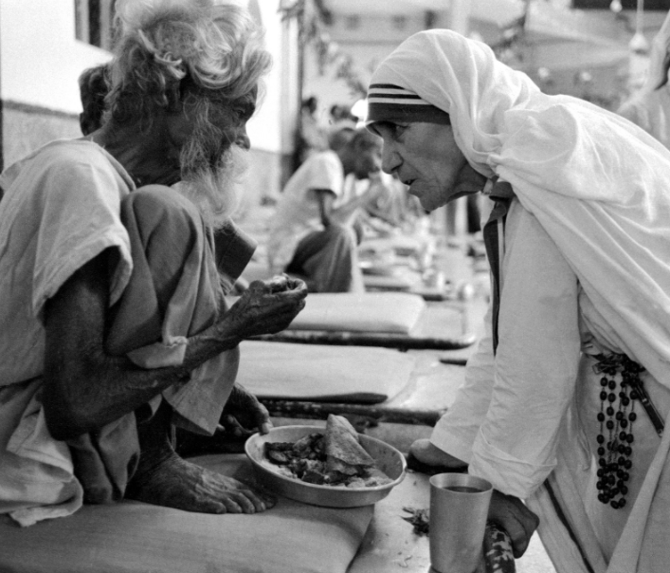
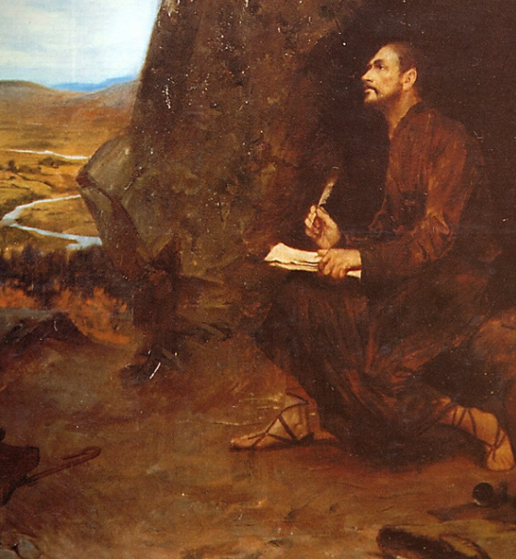
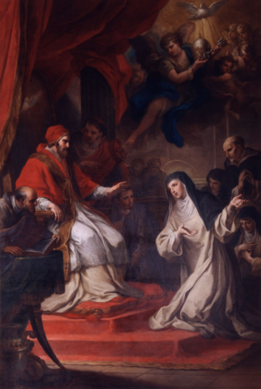








Slide 27
Two great sexual revolutions

Slide 29


Slide 30
The Social Sciences well done
Cannot but illustrate the way
God made man.

Slide 31
Building the new Culture
Emerging Global Culture

Slide 32




“To put this more positively:
the future of the Church, once again as always,
will be re-shaped by the saints, by people, that is,
whose minds probe deeper than the slogans of the day,
who see more than others see,
because their lives embrace a wider reality.
Unselfishness, which makes men free, is attained only
through the patience of small daily acts of self-denial.
By this daily passion,
which alone reveals to a man
in how many ways he is enslaved by his own ego,
by this daily passion and by it alone
a man's eyes are slowly opened. He sees
only to the extent that he has lived and suffered….”

Slide 33
Causation: Man is a relational being
---------------------------------------
Relationship
Conversation
Prayer
----------------------------------------------
Desire --- Imitation --- Rivalry

Slide 34
www.marri.us
marri.us/speeches_powerpoints
marripedia.org
Fagan@cua.edu

Slide 35

Tearing Society Apart
By Tearing Marriage Apart
Sexual Politics
Kate Millett, co-founder of NOW
“Why are we here today?” she [Kate Millett] asked.
“To make revolution,” they answered.
“What kind of revolution?” she replied.
“The Cultural Revolution,” they chanted.
“And how do we make Cultural Revolution?” she demanded.
“By destroying the American family!” they answered.
“How do we destroy the family?” she came back.
“By destroying the American Patriarch,” they cried exuberantly.
“And how do we destroy the American Patriarch?” she replied.
“By taking away his power!”
“How do we do that?”
“By destroying monogamy!” they shouted.
“How can we destroy monogamy?”
“By promoting promiscuity, eroticism, prostitution and homosexuality!” they resounded.
Kate Millett, co-founder of NOW
Source: Marxist Feminism’s Ruined Lives
Mallory Millet (sister of Kate Millet)
http://www.frontpagemag.com/2014/mallorymillett/marxist-feminisms-ruined-lives/

Slide 36


